Slide 1

ICC Cricket World Cup Prediction using Machine Learning
BY:
UDITH KUMAR TENE

Slide 2

CONTENTS
INTRODUCTION
APPLICATIONS
DATA
ENVIRONMENT AND TOOLS
WORKFLOW
DATA CLEANING
DATA ANALYSIS AND FEATURE ENGINEERING
INTERPRETATION FOR THE MODEL RESULTS
CONCLUSION

Slide 3
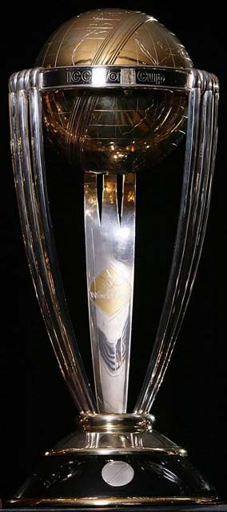
INTRODUCTION
ICC cricket World Cup organised For every 4 years preliminary qualification round leading upto finals tournament
The tournament will be contested by 10 teams who will be playing in a single round-robin group, with the top four at the end of the group phase progressing to the semi-finals.

Slide 4

DATA
The Data is taken from Cricbuzz website comprising of rankings of teams as of today and details of each team’s history in previous world cups.
In this the data is taken from 1975 to 2019 and manual cleaning of the data is done to make my machine learning model out of it.

Slide 5

ENVIRONMENT AND TOOLS
Jupyter Notebook
Numpy
Pandas
Seaborn
Matplotlib
Scikit-learn

Slide 6
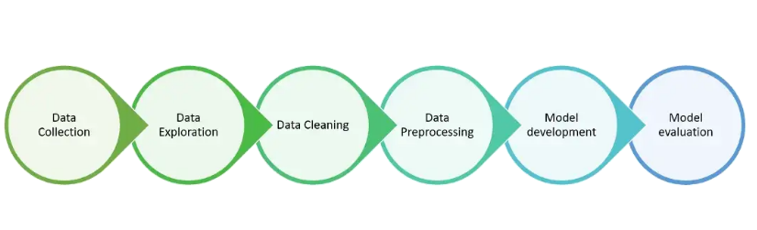
WORKFLOW

Slide 7

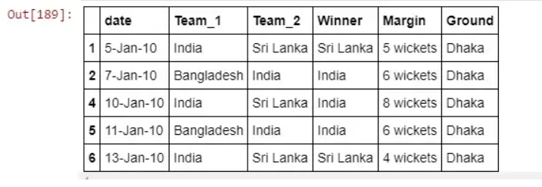
DATA CLEANING

Slide 8
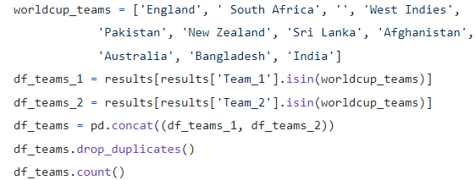
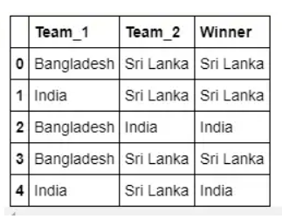
DATA ANALYSIS AND FEATURE ENGINEERING
The details of the teams participating this year with their past results.

Slide 9
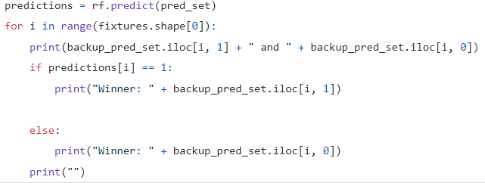
INTERPRETATION FOR THE MODEL RESULTS
Finally, the below code is for getting the results for each and every league stage match.

Slide 10
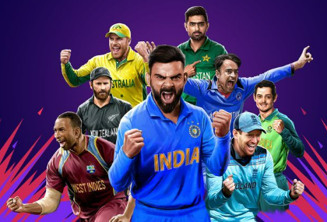
CONCLUSION
By running this code we’ll get to know the winner of the final.

Slide 11


